Slide 1


Cybersecurity through an Ontological Lens
John Beverley
Assistant Professor, University at Buffalo
Co-Director, National Center for Ontological Research
Affiliate Faculty, Institute of Artificial Intelligence and Data Science

Slide 2
Outline
Directed Graphs and the Semantic Web
Cybersecurity Landscape

Slide 3
Outline
Directed Graphs and the Semantic Web
Cybersecurity Landscape

Slide 4
Undirected Graph

Slide 5
Directed Graph

Slide 6
Labeled Property Directed Graph
On: 1-5-24
On: 1-2-20
has part
part of

Slide 7
Typed Labeled Property Directed Graph
Type: Person
ID: Joe
On: 1-5-24
On: 1-2-20
has part
part of
Type: Hand
Type: Person
ID: Sam
ID: Rose

Slide 8
“Labeled Property Graph”
Type: Person
ID: Joe
On: 1-5-24
On: 1-2-20
has part
part of
Type: Hand
Type: Person
ID: Sam
ID: Rose

Slide 9
Undirected Graph

Slide 10
Directed Graph

Slide 11
Labeled Directed Graph
“Joe”
has label
has part
part of
has label
“Sam”
“Rose”

Slide 12
Typed Labeled Directed Graph
“Hand”
“Joe”
“Person”
has label
has label
has label
type
type
has part
part of
type
has label
“Sam”
“Rose”

Slide 13
Logically Typed Labeled Directed Graph
“Hand”
“Joe”
“Person”
has label
has label
has label
type
type
has part
part of
type
part of
has label
“Sam”
“Rose”

Slide 14
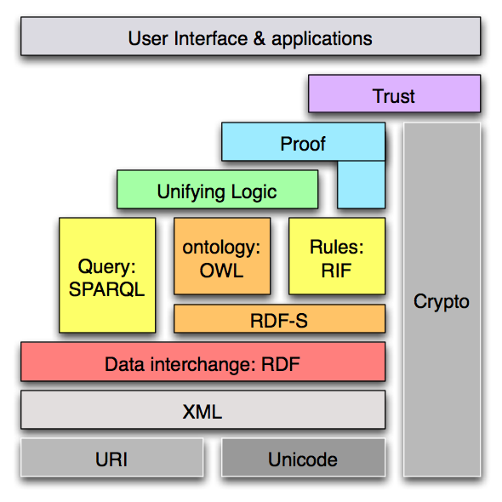
Logically Typed Labeled Directed Graph
“Hand”
“Joe”
“Person”
has label
has label
has label
type
type
has part
part of
type
part of
has label
“Sam”
“Rose”

Slide 15
RDF Graph Database
W3C Standard
Open-World Assumption
Optimized for federated querying and graph traversal
SPARQL is a least as expressive as SQL
Supports automated reasoning
Linked data read natively
Property Graph Database
No industry standard
Closed World Assumption
Graph traversal fast if you know what you’re looking for
Cypher cannot represent disjunction or negation
No native reasoning support
Hard to read linked data

Slide 16
Semantic Web Stack

Slide 17
Semantic Web Stack
“RDF” stands for:
Resource: Everything that can have a unique identifier, e.g. pages, places, people, dogs, products...
Description: attributes, features, and relations of among resources
Framework: model, languages and syntaxes for these descriptions
RDF is:
A data model
That is based on triples
Which provide semantics for distributed web data

Slide 18
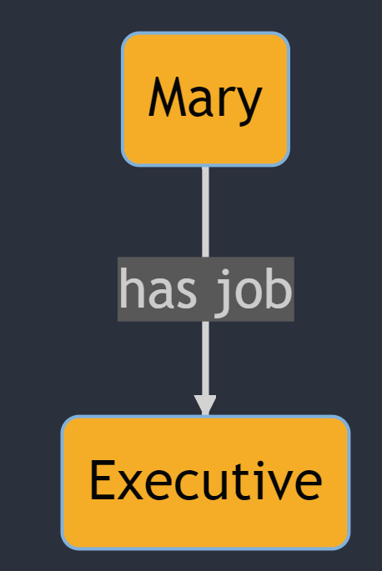
Triple Example

Slide 19
Triple Example
subject

Slide 20
Triple Example
subject
predicate

Slide 21
Triple Example
subject
predicate
object

Slide 22
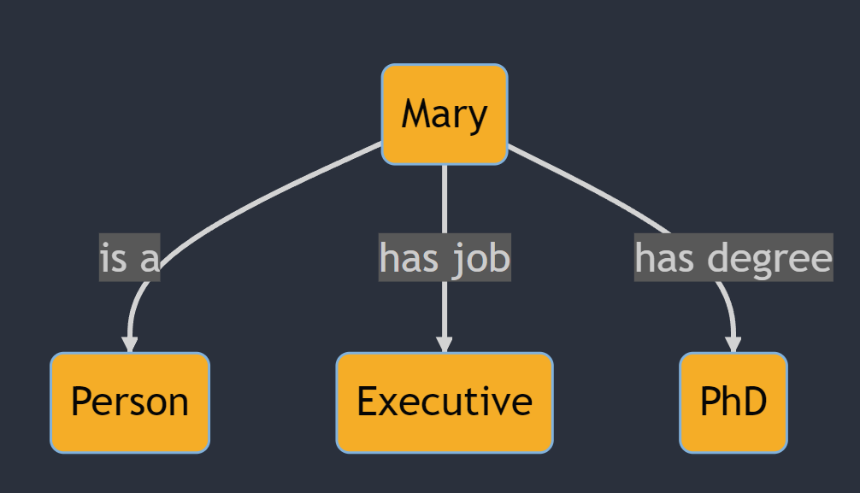
Triple Example

Slide 23
Triple Example
subject

Slide 24
Triple Example
predicate
subject

Slide 25
Triple Example
predicate
subject
object

Slide 26
RDF Triple Structure
Uniform Resource
Identifier (URI)
<https://www.example.com/occupation/Mary> <https://www.example.com/occupation/has_job> <https://www.example.com/occupation/Executive>
Subject
Predicate
Object

Slide 27
RDF Vocabulary
RDF is a very simple data model, with a very simple vocabulary:
rdf:Property
rdf:type
rdf:Statement
rdf:subject
rdf:predicate
rdf:object
rdf:Bag
rdf:List
rdf:first
rdf:rest
rdf:nil

Slide 28
Semantic Web Stack
The “S” in RDFS stands for:
Schema – A syntax and semantics for an intended extension of the RDF syntax
RDFS is:
A vocabulary
That is based on the RDF data model
That extends the RDF vocabulary
And provide semantics for connecting RDF resources

Slide 29
Resource Description Framework Schema
RDFs is an extension of RDF facilitating representation of:
rdfs:Class
rdfs:subClassOf
rdfs:domain
rdfs:range
rdfs:subPropertyOf
rdfs:Resource
rdfs:Datatype
rdfs:Literal
rdfs:label
rdfs:comment
rdfs:isDefinedBy

Slide 30
Semantic Web Stack
“OWL” stands for:
Web
Ontology
Language
OWL is:
A family of vocabularies
That extend RDF and RDFS
Which provide semantics for constructing logical relationships among resources

Slide 31
Outline
Directed Graphs and the Semantic Web
Cybersecurity Landscape

Slide 32

2012 LinkedIn Hack
Passwords for nearly 6.5 million users were stolen by Russian cybercriminals, in particular Yevgeniy Nikulin
In 2016, LinkedIn discovered 100 million email addresses and hashed passwords had also been stolen
In 2021, a torrent file was made available with data for over 700 million users, much of which could be traced to the linkedIn breach

Slide 33

Cause for Alarm
You might be thinking “I don’t really use LinkedIn, so I’ve no reason to worry...”
I bet you reuse passwords...
We create new accounts all the time...
We reuse passwords all the time...

Slide 34
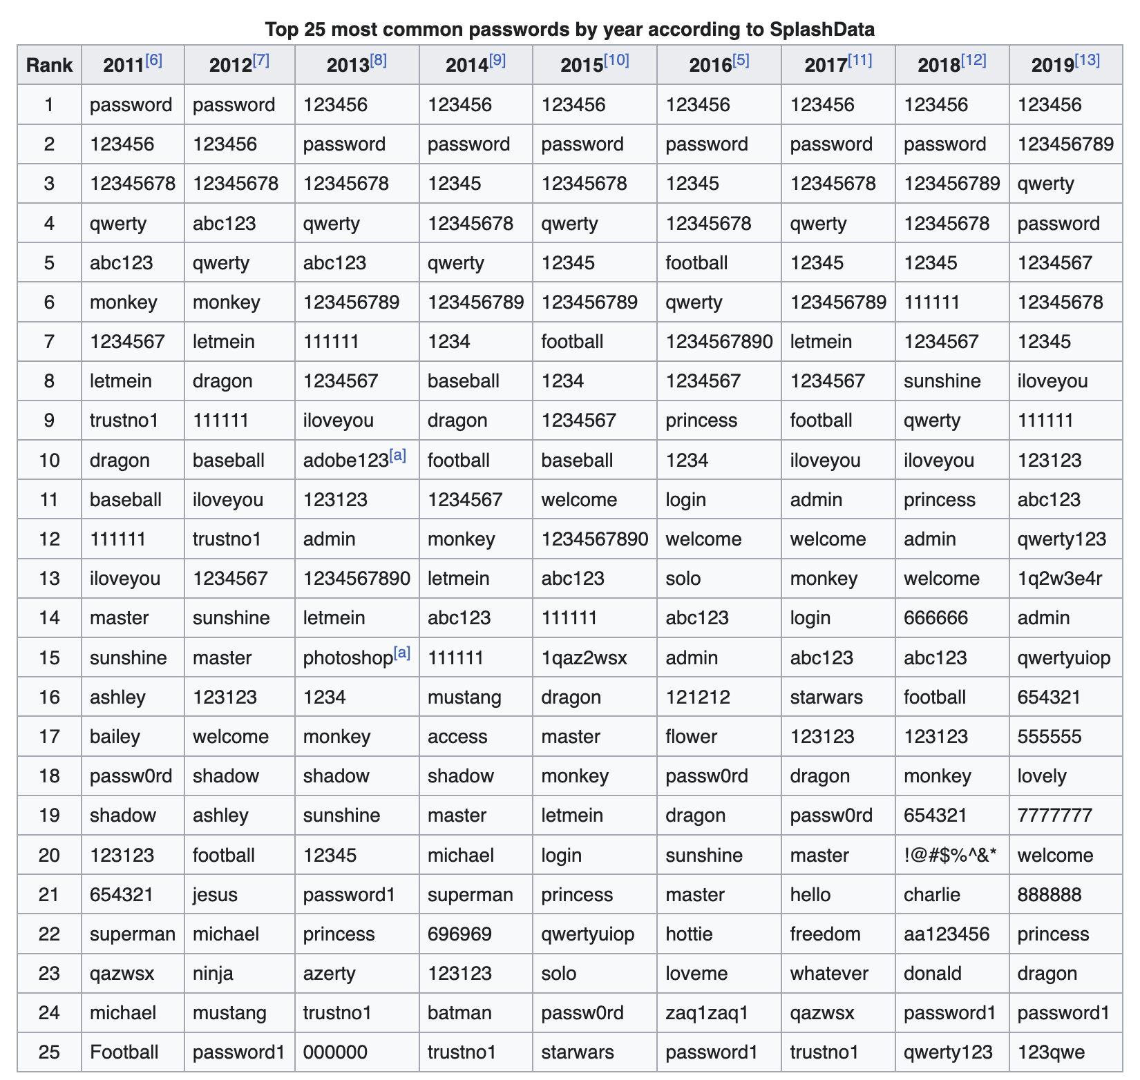

Slide 35
Be honest, how many of you have used the password “password” or “123456” before?

Slide 36
Be honest, how many of you have used the password “111111” before?

Slide 37
Be honest, how many of you have used the password “dragon” before?

Slide 38

Breadcrumbs
Compromising a single account leads to information that can be used to compromise other accounts
With your name and address, someone could call a credit card provider and – because they often ask for this information first – learn if you have a card
Breadcrumbs lead to bread:
Date of Birth
Social Security Number
Security Questions and Answers

Slide 39

https://haveibeenpwned.com/

Slide 40

https://haveibeenpwned.com/

Slide 41
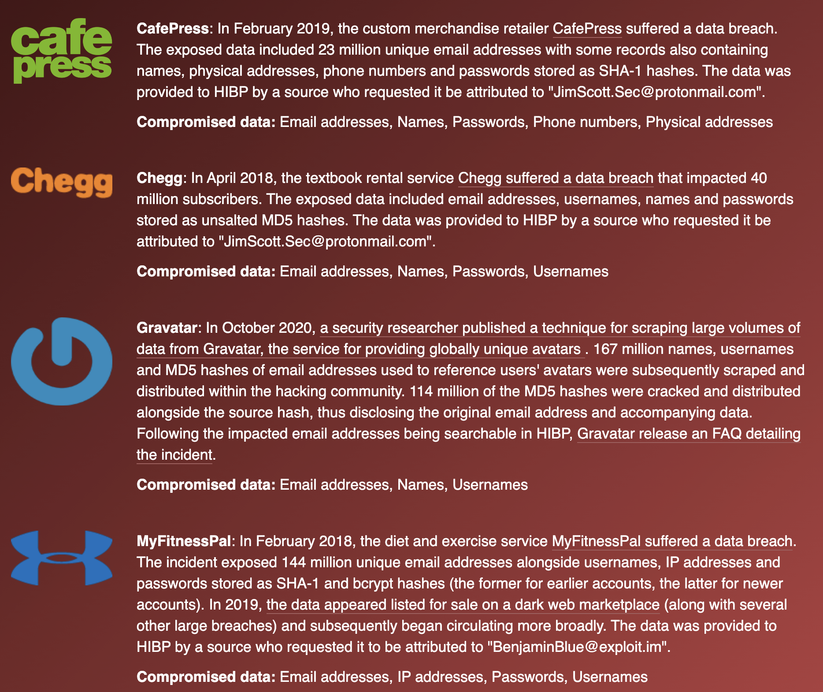
Why Yes I Have
I’ve had this email address for over 10 years
It’s not a matter of if so much as a matter of when
I’m surprised it’s only appeared in 4 breaches

Slide 42
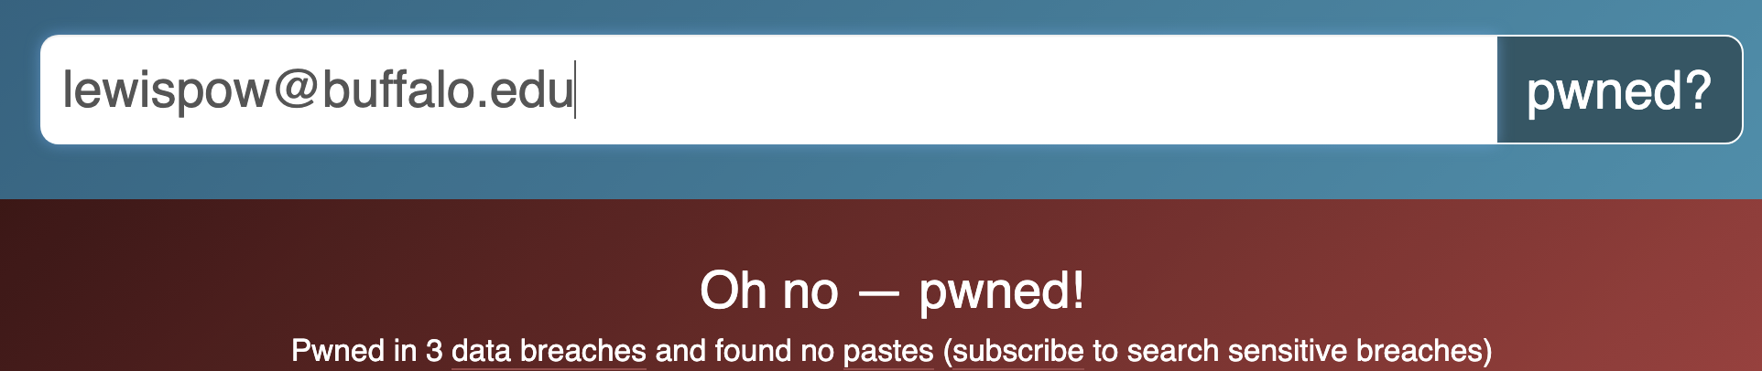
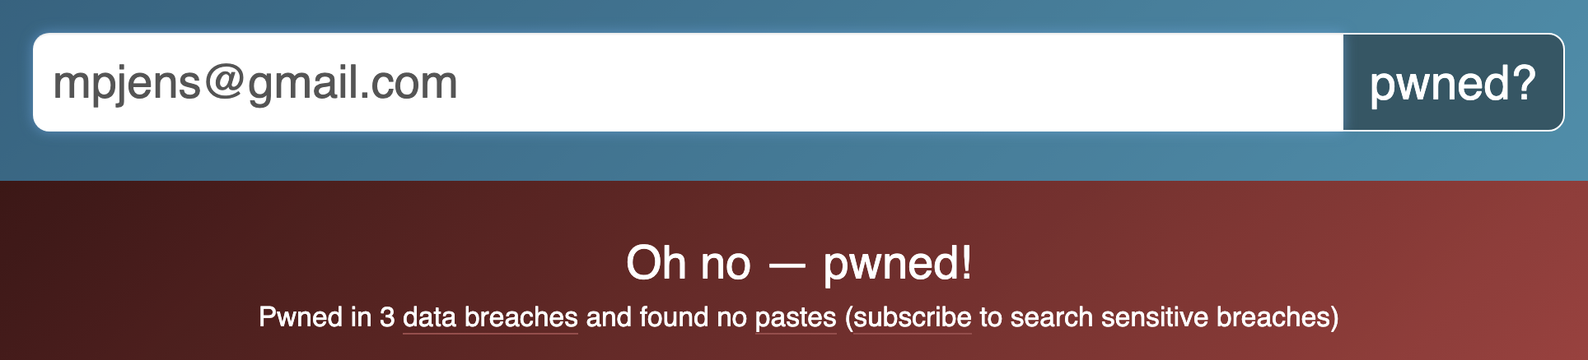
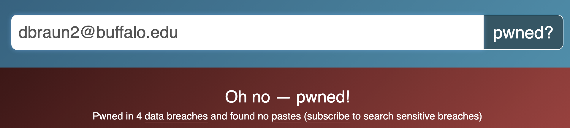

Slide 43
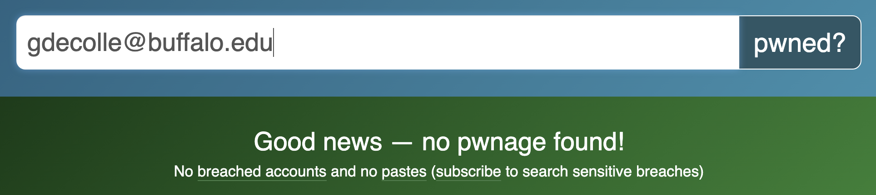
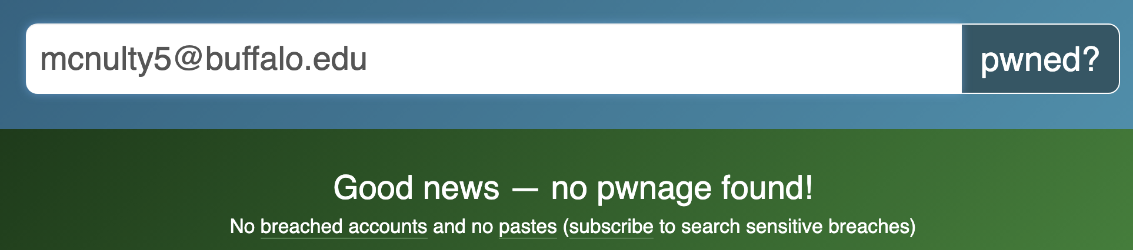
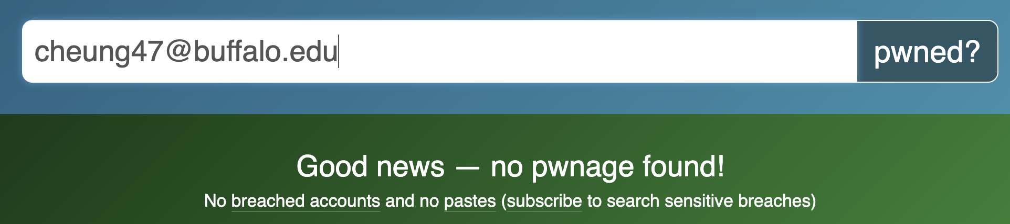

Slide 44
Group Exercise
Because I know you’re not going to be able to resist, navigate to the “Have I been pwned?” website and explore whether your email accounts have been compromised
You’re welcome to discuss in small groups
Keep in mind, we’ll be discussing as a class

Slide 45


Open Source Intelligence OSINT
OSINT is intelligence that can be gathered from publicly available sources
For example, social and print media, public government data, professional publications, commercial data, etc.

Slide 46
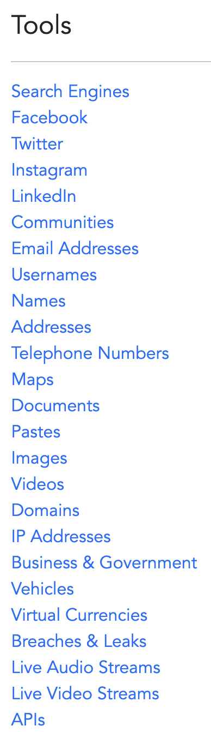
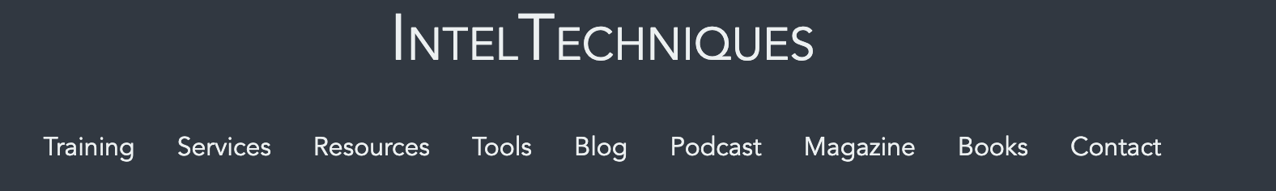

Slide 47

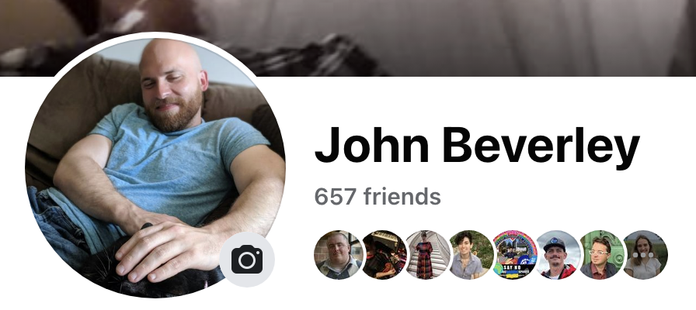

Slide 48
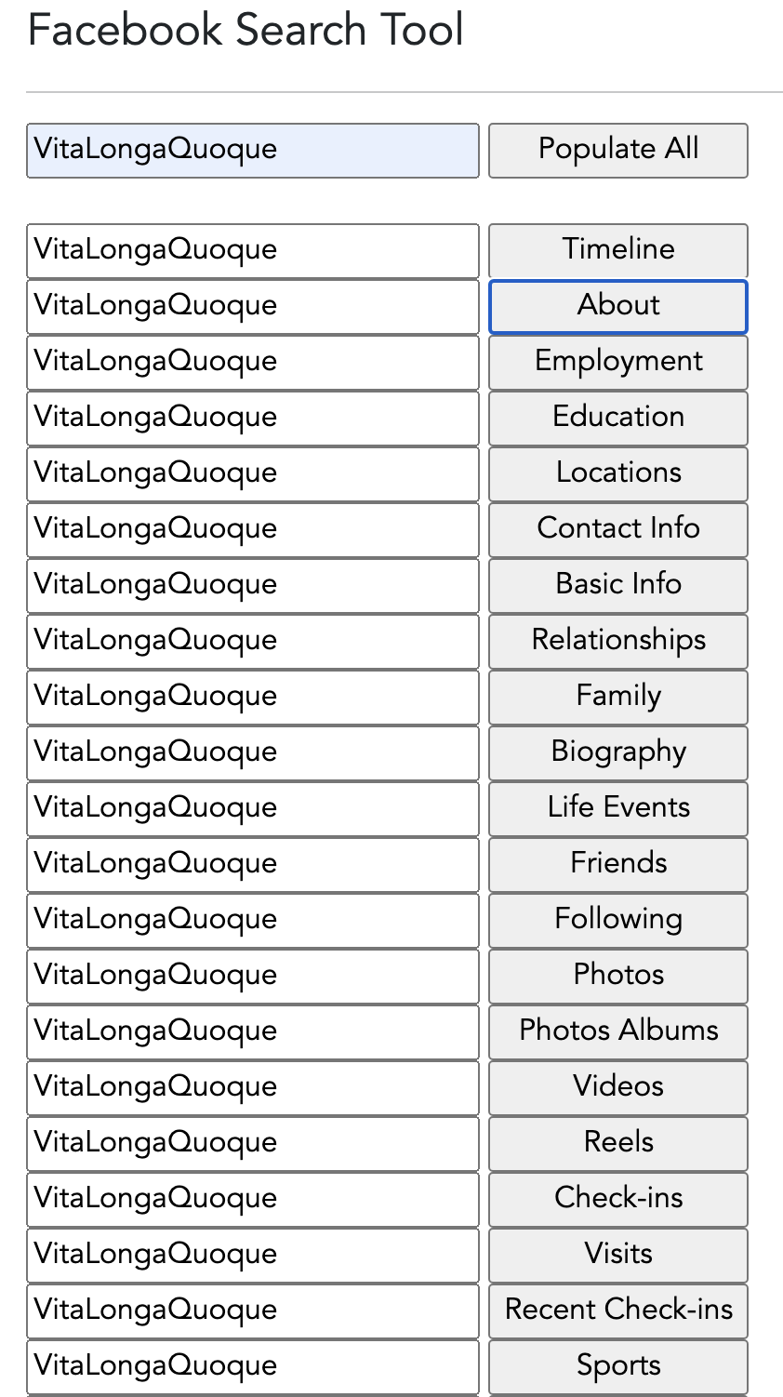

Slide 49
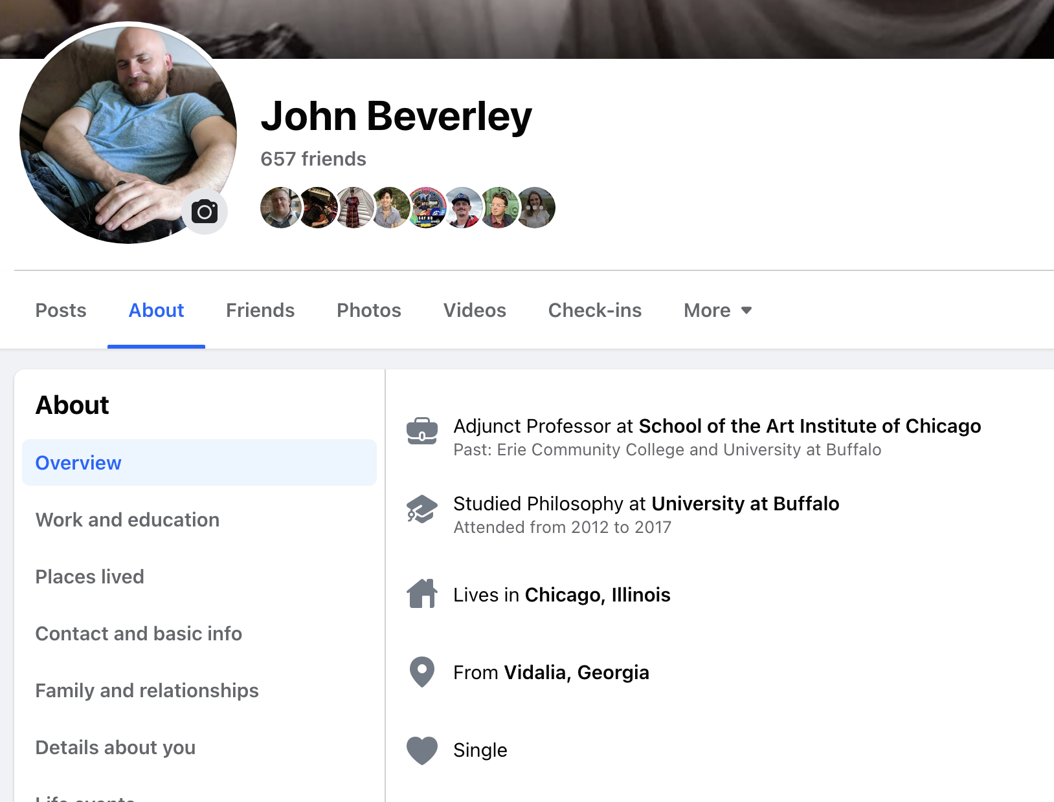

Slide 51
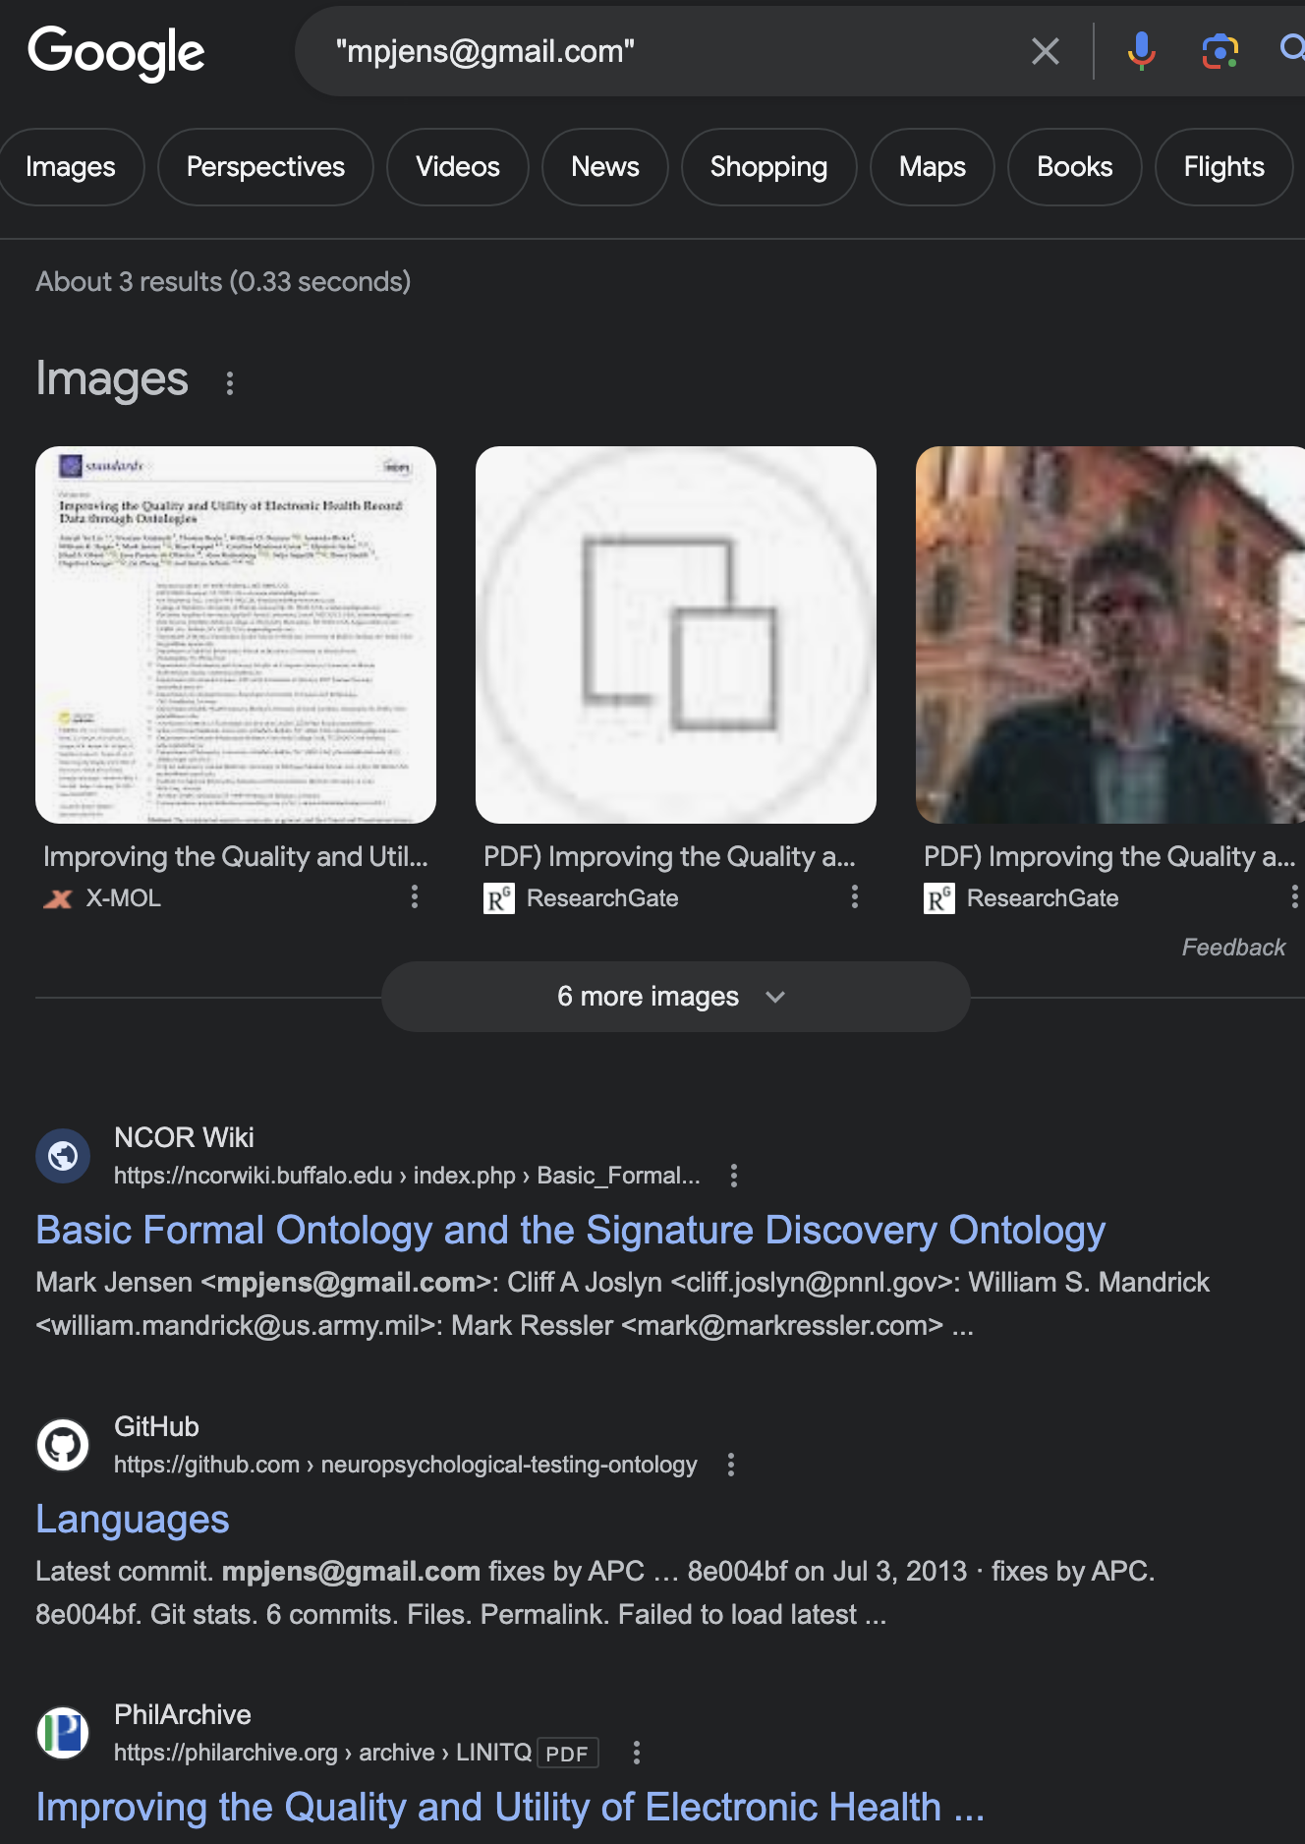
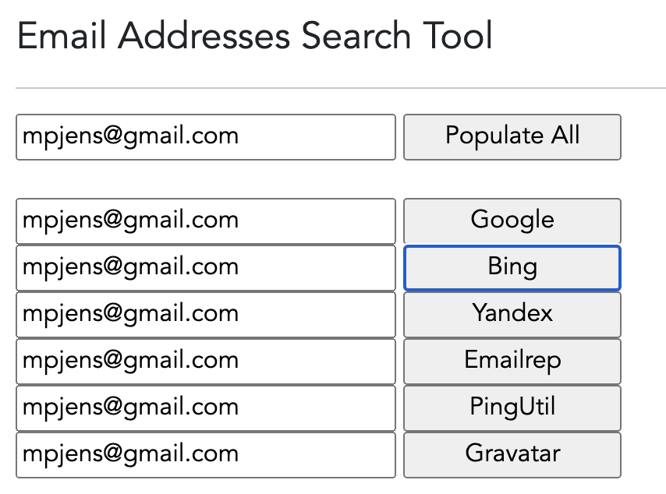

Slide 52
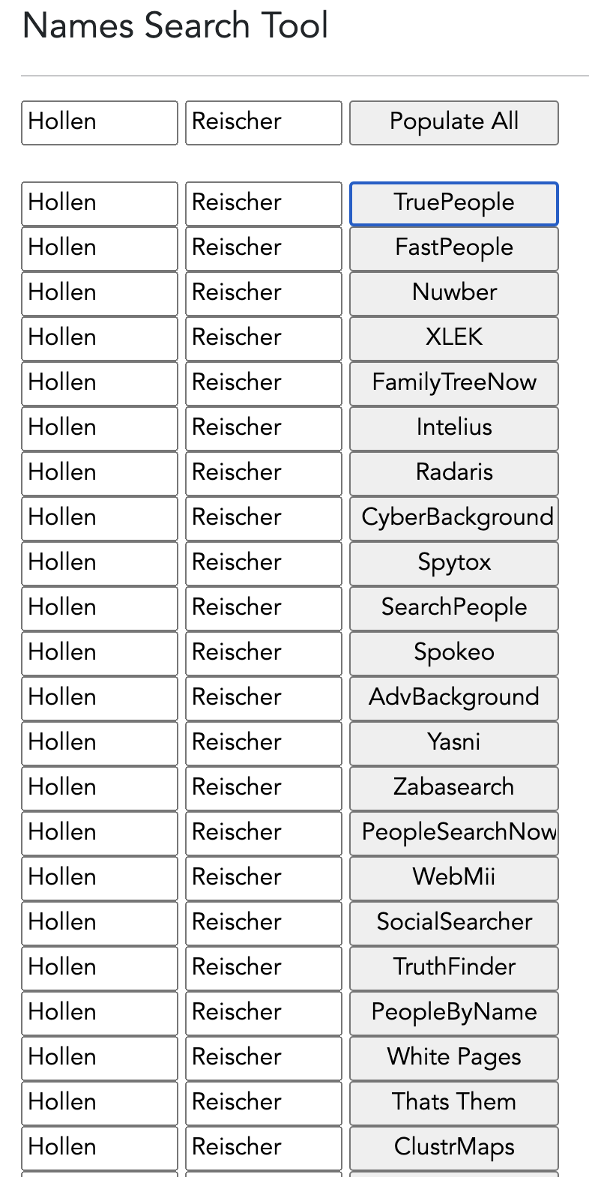
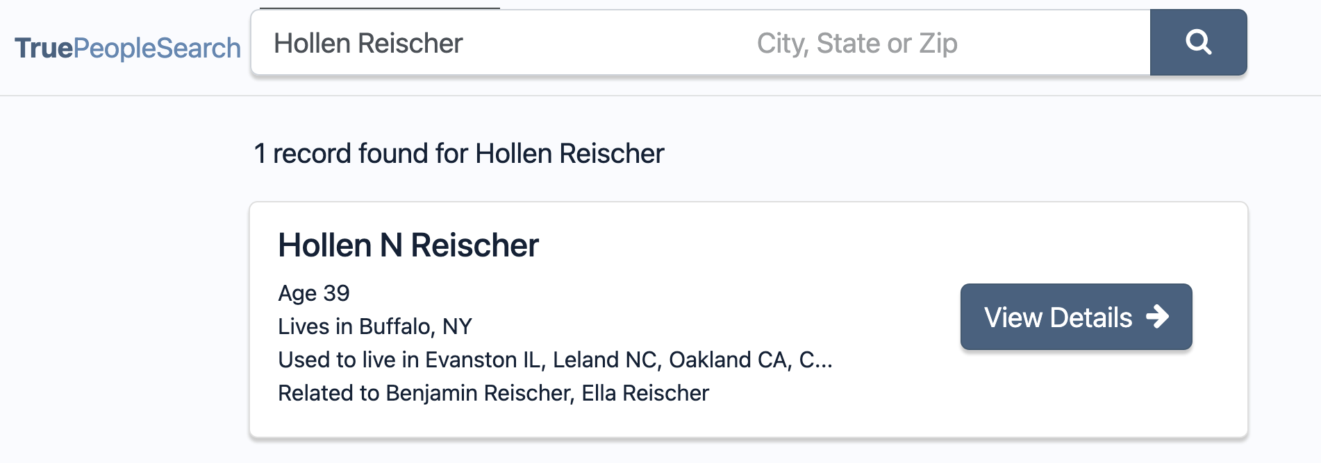

Slide 53
Group Exercise
Because I know you’re not going to be able to resist, navigate to the “OSINT” website and explore what sorts of information is available about you online
You’re welcome to discuss in small groups
Keep in mind, we’ll be discussing as a class

Slide 54
Need for Speed
Hackers need 15 hours to compromise a system; defenders need 200-300 days to discover a breach
Identifying vulnerabilities and potential exploits in software and hardware early and often is of paramount importance
The variety and complexity of cybersecurity data strikes me as analogous to the human genome project...

Slide 55

Proliferation of Ontologies
When developed correctly, ontologies provide common vocabularies with common semantics across multiple domains
The success of the Gene Ontology led to a proliferation of ontologies developed by subject-matter experts, computer scientists, and logicians
Almost none of which were developed in coordination
The result was massive incompatibility of terms and relations, confusion, in-fighting, name-calling, etc.

Slide 56
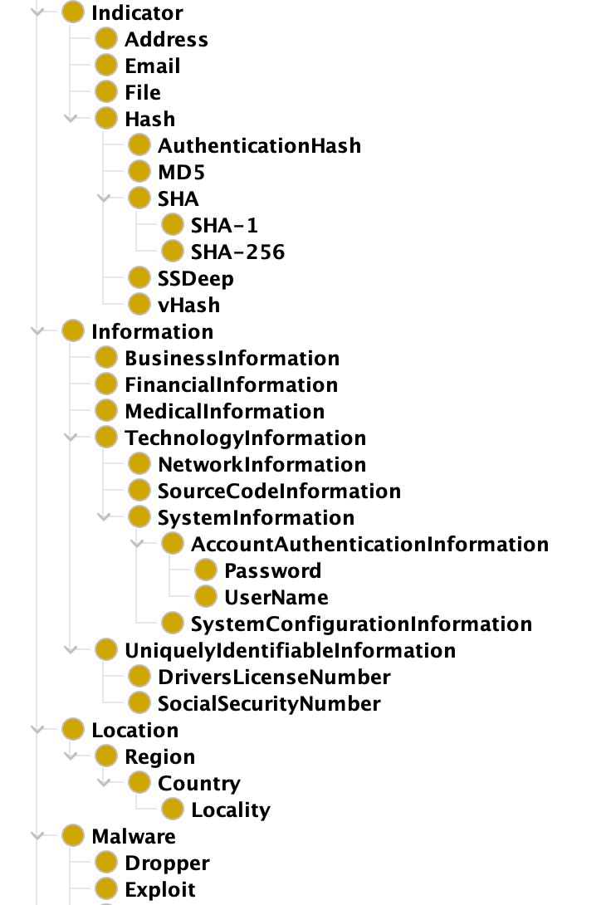
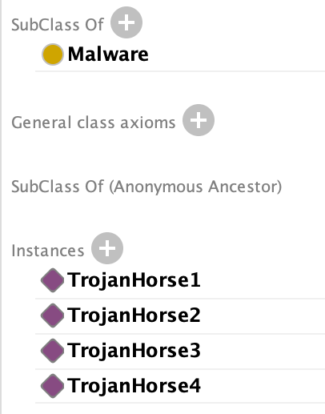
The Malware Ontology (MalOnt)
Developed by Nidhi Ristogi at RIT
Designed to provide design patterns for common malware attacks and defense postures...
I guess...it’s hard to say since there’s no description of the scope in the ontology

Slide 57
The Malware Ontology (MalOnt)
Developed by Nidhi Ristogi at RIT
Designed to provide design patterns for common malware attacks and defense postures...
I guess...it’s hard to say since there’s no description of the scope in the ontology

Slide 58
The Malware Ontology (MalOnt)
Developed by Nidhi Ristogi at RIT
Designed to provide design patterns for common malware attacks and defense postures...
I guess...it’s hard to say since there’s no description of the scope in the ontology

Slide 59
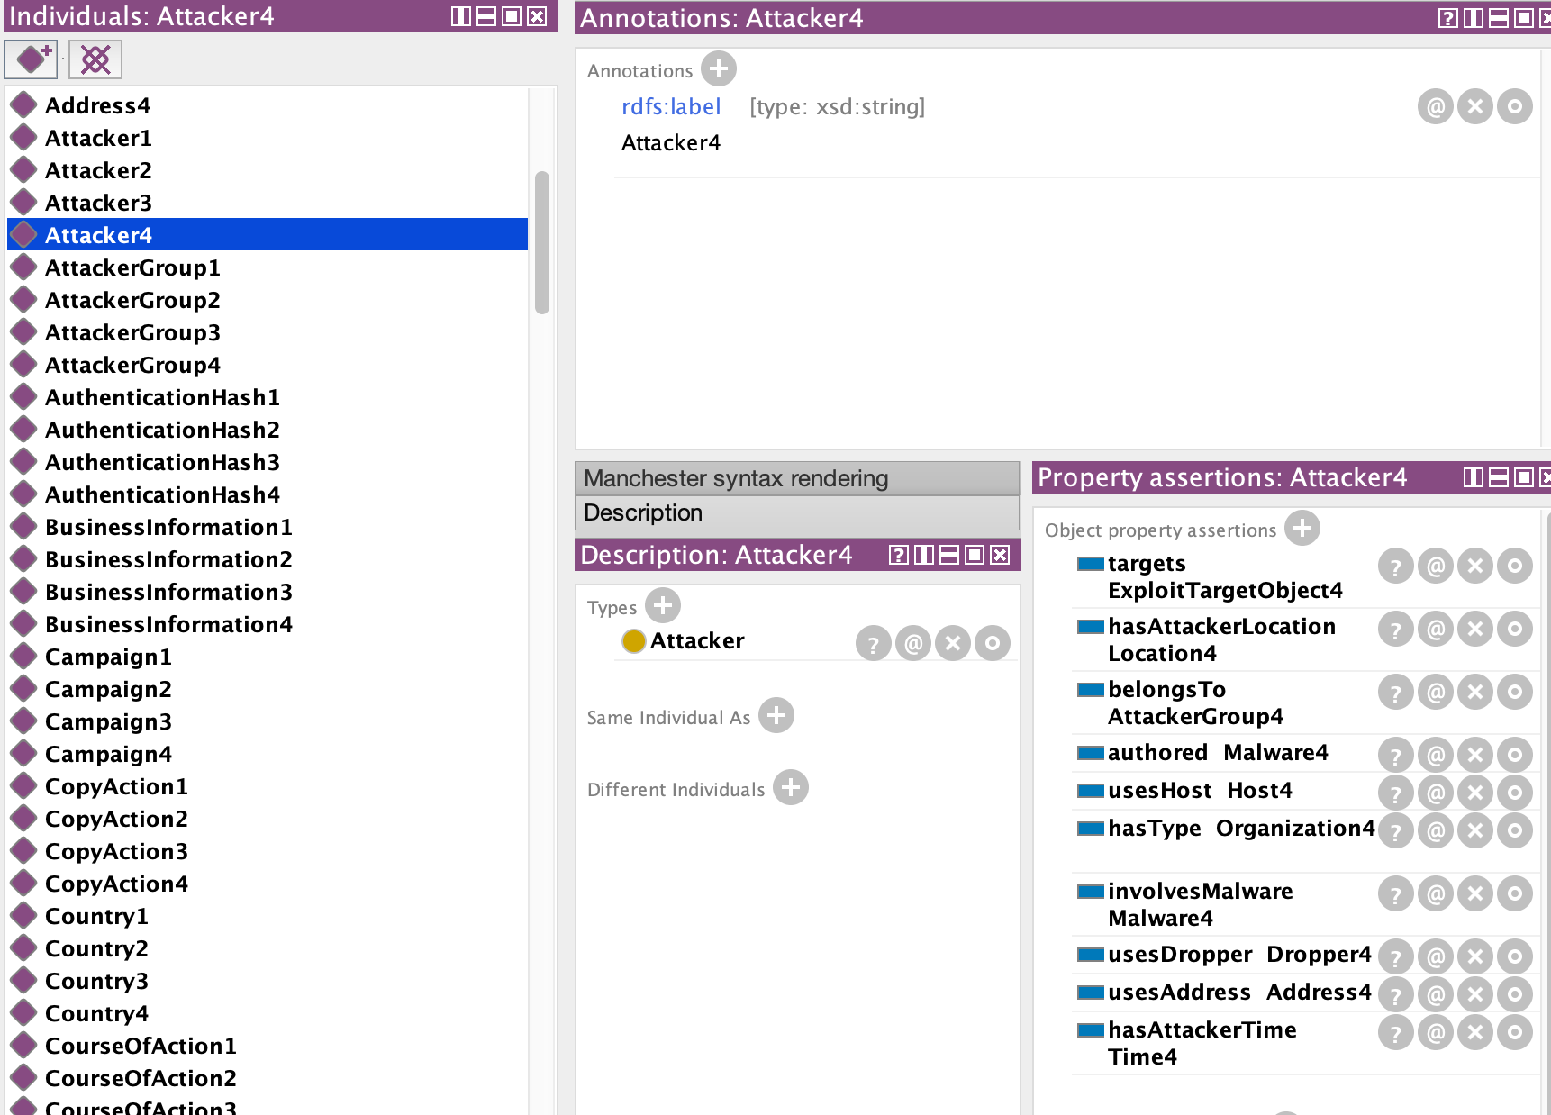
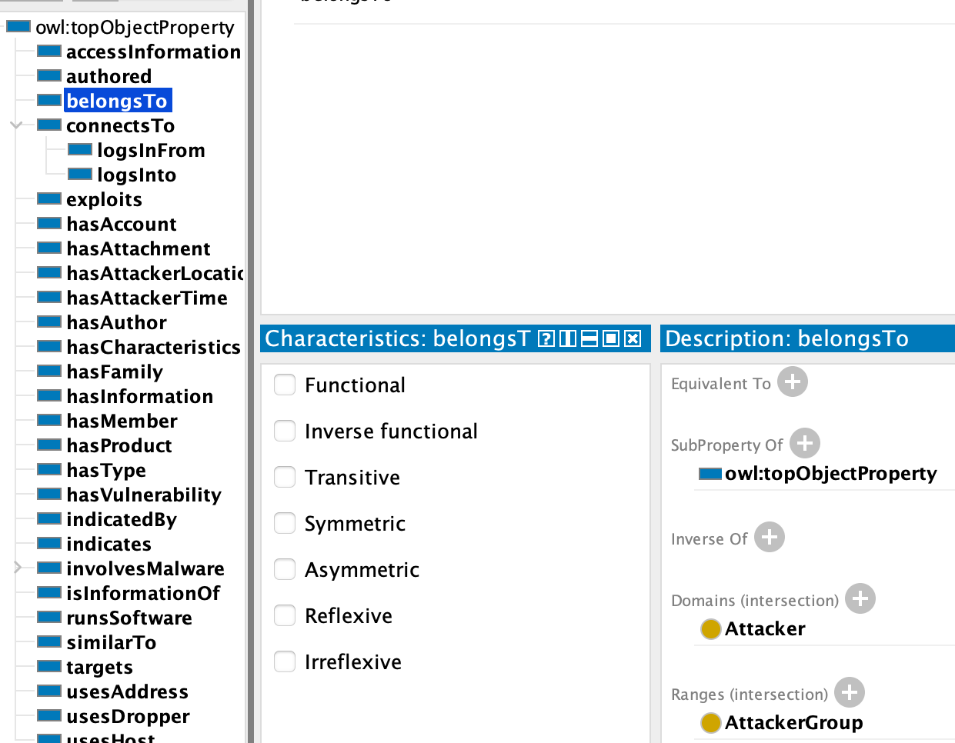
No Formal Properties
No Justification or Descriptions

Slide 60
No Formal Properties
No Justification or Descriptions

Slide 61
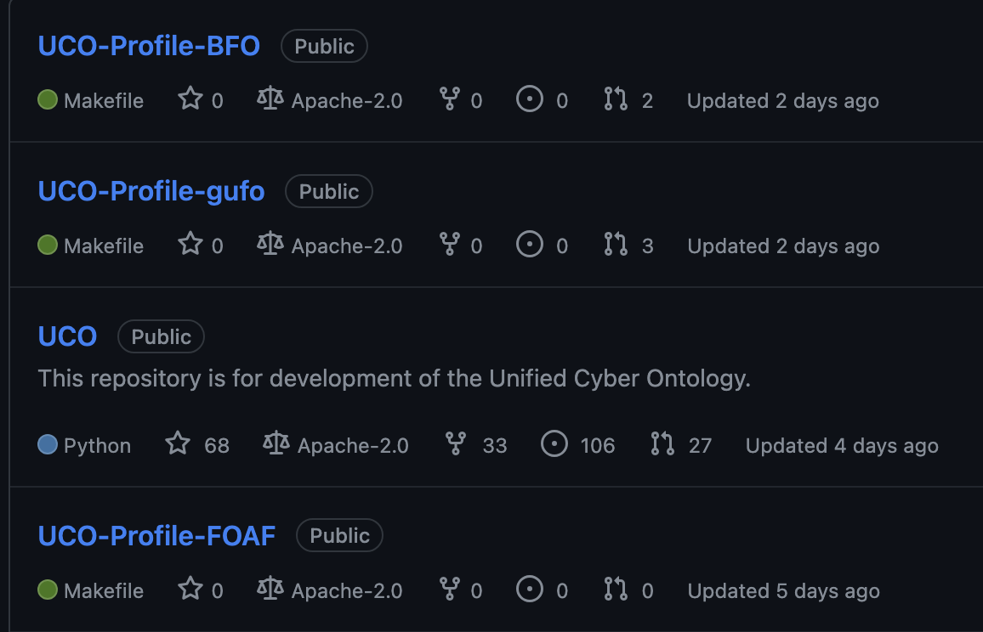
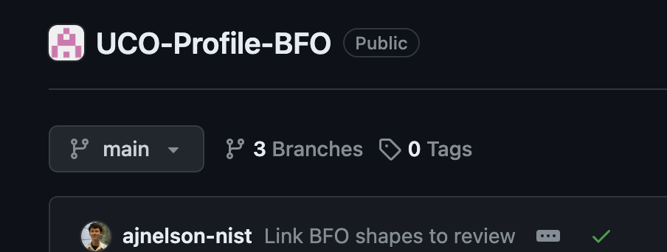
Unified Cyber Ontology (UCO)
Designed to integrate heterogeneous cyber datasets and provide a foundation for mapping cyber data to Semantic Web resources, e.g. Linked Open Data, DBPedia, Yago Knowledge Base
Also mapping to top-level ontologies

Slide 62
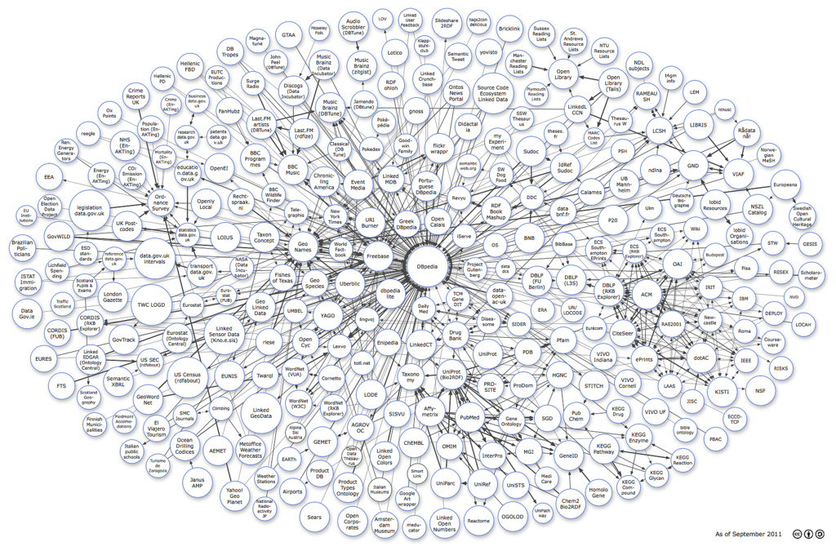
Unified Cyber Ontology (UCO)
Designed to integrate heterogeneous cyber datasets and provide a foundation for mapping cyber data to Semantic Web resources, e.g. Linked Open Data, DBPedia, Yago Knowledge Base
However, semantic web resources vary widely in their coherence.

Slide 63
Yago Knowledge Base
Yago extracts content from Wikipedia’s crowd sourced pages, which is then automatically annotated with ontology terms
Illustrative examples:
An elephants’ graveyard is a mammal
A Lockheed Martin A2100 is a person
The Berneuse Mountain is a cable car
UCO coordinates cyber data with data from other domains but the results cannot be trusted

Slide 64
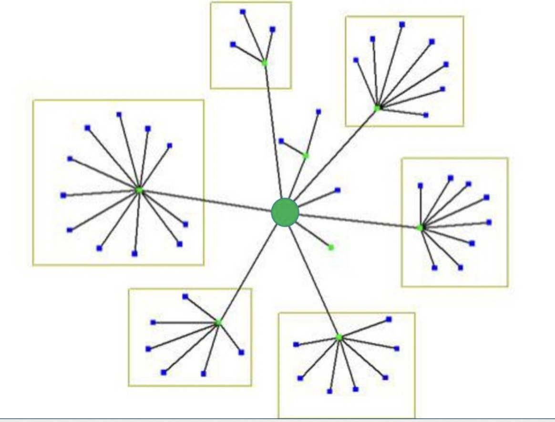
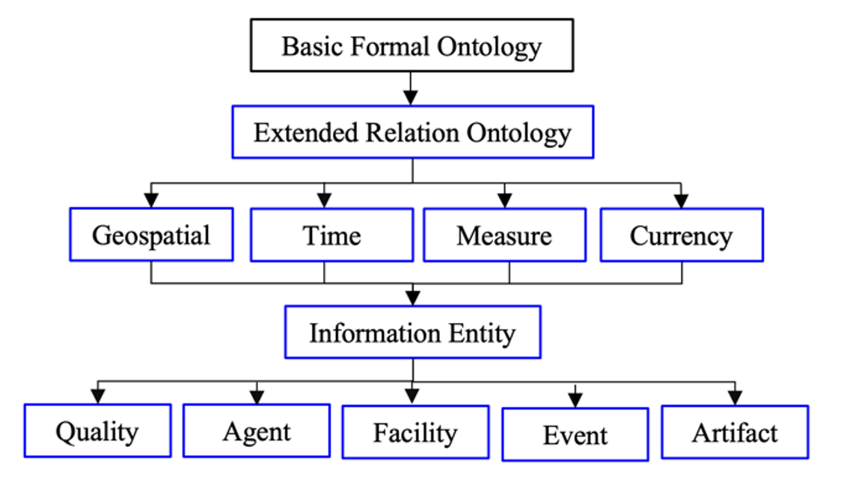
Cyber Ontology (C3O)
Leveraged vetted, widely-used open-source standards
Developed following ”downward population” strategy starting with the Basic Formal Ontology and Common Core Ontologies

Slide 65

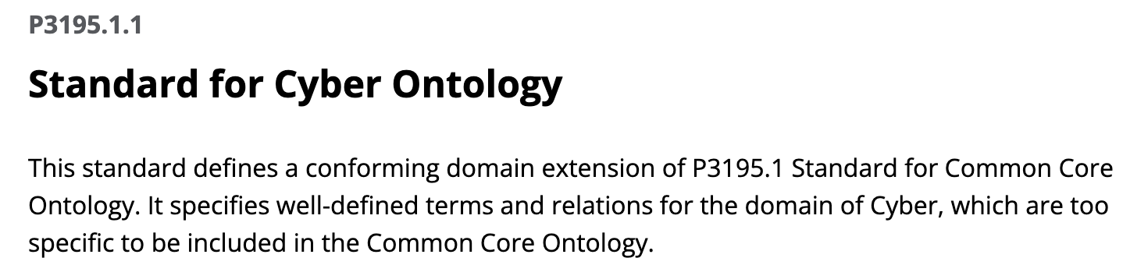
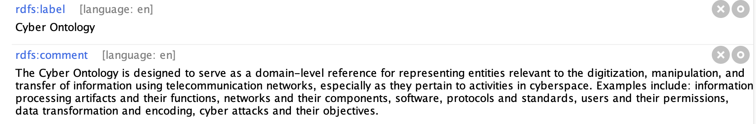
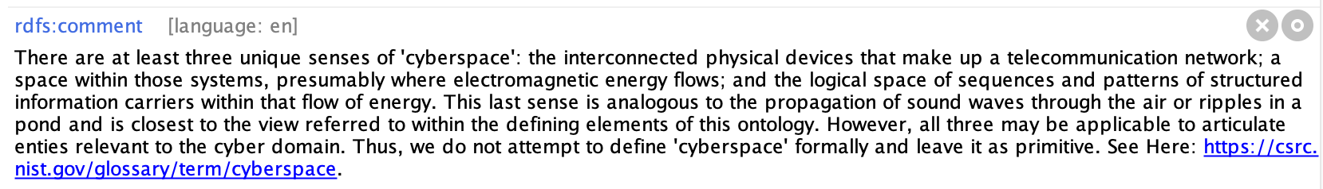

Slide 66
Scope of Cyber Ontology (C3O)
Network Devices:
hardware components, data storage, software systems and applications, network requests
Network Infrastructure:
servers, clients, addresses, ports, nodes, endpoints, switches, routers
Network Traffic:
network connections, permissions, protocols, connection states, packet transfer
Threat Actors:
threat indicators, cyber attack types, effects, and severity, adversary capabilities

Slide 67
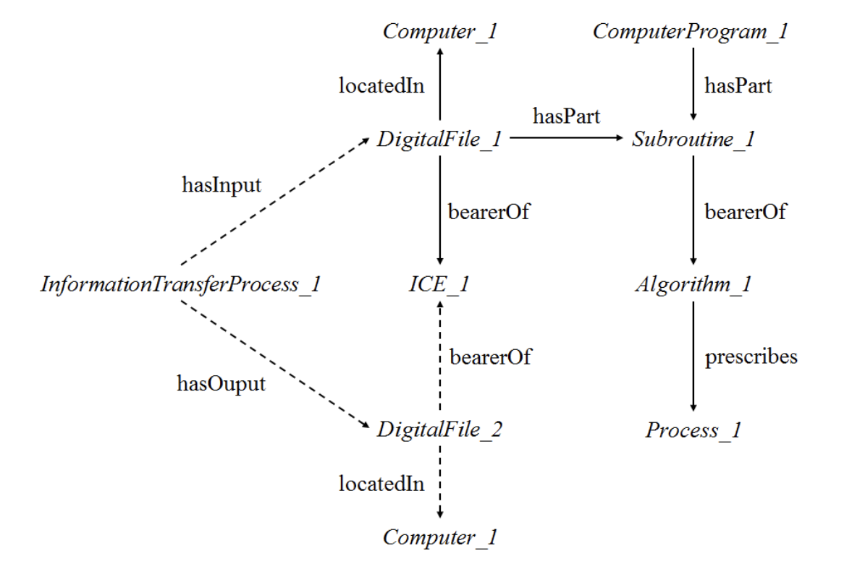

Slide 68
Cyber Ontology (C3O)
Algorithm =_{def} An ICE that prescribes the inputs and outputs of mathematical functions as well as workflow of execution for achieving a predefined objective.
Subroutine =_{def} An information processing artifact that is designed to bear an algorithm and to be executed within the context of some computer program.
Computer program =_{def} An information processing artifact that consists of a collection of subroutines that is designed to be executed by a processing unit to perform a specific task.

Slide 69
Group Exercise
Gather into small groups and reflect on the definitions presented
In light of your earlier research and the motivations I’ve given here, I would like to you investigate the plausibility of these definitions
Because they are definitions, the left-hand side of the “=_{def}” accurately applies to some phenomena just in case the right-hand side does

Slide 70
Cyber Ontology (C3O)
Algorithm =_{def} An ICE that prescribes the inputs and outputs of mathematical functions as well as workflow of execution for achieving a predefined objective.
Subroutine =_{def} An information processing artifact that is designed to bear an algorithm and to be executed within the context of some computer program.
Computer program =_{def} An information processing artifact that consists of a collection of subroutines that is designed to be executed by a processing unit to perform a specific task.

Slide 71

Cyber Ontology (C3O)
Algorithm =_{def} An ICE that prescribes the inputs and outputs of mathematical functions as well as workflow of execution for achieving a predefined objective.
Subroutine =_{def} An information processing artifact that is designed to bear an algorithm and to be executed within the context of some computer program.
Computer program =_{def} An information processing artifact that consists of a collection of subroutines that is designed to be executed by a processing unit to perform a specific task.

Slide 72
Cyber Ontology (C3O) vs Beverley
Intelligence gathering =_{def} Covert behavior aimed at acquiring information to promote the interests of an individual or collective, using methods of collection, processing, integration, evaluation, analysis, or interpretation deemed reliable by the individual or collective
Act of Intelligence Gathering =_{def} A Planned Act of producing and/or gathering information by a government or other Organization to guide decisions and actions by answering questions or obtaining advance warning of events and movements deemed to be important or otherwise relevant

Slide 73
Group Exercise
Gather into small groups and reflect on the definitions presented
In light of your earlier research and the motivations I’ve given here, I would like to you investigate the plausibility of these definitions
Because they are definitions, the left-hand side of the “=_{def}” accurately applies to some phenomena just in case the right-hand side does

Slide 74
Cyber Ontology (C3O) vs Beverley
Intelligence gathering =_{def} Covert behavior aimed at acquiring information to promote the interests of an individual or collective, using methods of collection, processing, integration, evaluation, analysis, or interpretation deemed reliable by the individual or collective
Act of Intelligence Gathering =_{def} A Planned Act of producing and/or gathering information by a government or other Organization to guide decisions and actions by answering questions or obtaining advance warning of events and movements deemed to be important or otherwise relevant

Slide 75
Cyber Ontology (C3O) vs Beverley
Intelligence gathering =_{def} Covert behavior aimed at acquiring information to promote the interests of an individual or collective, using methods of collection, processing, integration, evaluation, analysis, or interpretation deemed reliable by the individual or collective
Act of Intelligence Gathering =_{def} A Planned Act of producing and/or gathering information by a government or other Organization to guide decisions and actions by answering questions or obtaining advance warning of events and movements deemed to be important or otherwise relevant
Redundant

Slide 76
Cyber Ontology (C3O) vs Beverley
Intelligence gathering =_{def} Covert behavior aimed at acquiring information to promote the interests of an individual or collective, using methods of collection, processing, integration, evaluation, analysis, or interpretation deemed reliable by the individual or collective
Act of Intelligence Gathering =_{def} A Planned Act of producing and/or gathering information by a government or other Organization to guide decisions and actions by answering questions or obtaining advance warning of events and movements deemed to be important or otherwise relevant
Ambiguous

Slide 77
Cyber Ontology (C3O) vs Beverley
Intelligence gathering =_{def} Covert behavior aimed at acquiring information to promote the interests of an individual or collective, using methods of collection, processing, integration, evaluation, analysis, or interpretation deemed reliable by the individual or collective
Act of Intelligence Gathering =_{def} A Planned Act of producing and/or gathering information by a government or other Organization to guide decisions and actions by answering questions or (obtaining advance warning of events and movements deemed to be important or otherwise relevant)
Trivial

Slide 78
Cyber Ontology (C3O) vs Beverley
Intelligence gathering =_{def} Covert behavior aimed at acquiring information to promote the interests of an individual or collective, using methods of collection, processing, integration, evaluation, analysis, or interpretation deemed reliable by the individual or collective
Act of Intelligence Gathering =_{def} A Planned Act of producing and/or gathering information by a government or other Organization to guide decisions and actions (by answering questions or obtaining advance warning of events and movements) deemed to be important or otherwise relevant
Better

Slide 79
Cyber Ontology (C3O) vs Beverley
Intelligence gathering =_{def} Covert behavior aimed at acquiring information to promote the interests of an individual or collective, using methods of collection, processing, integration, evaluation, analysis, or interpretation deemed reliable by the individual or collective
Act of Intelligence Gathering =_{def} A Planned Act of producing and/or gathering information by a government or other Organization to guide decisions and actions by answering questions or obtaining advance warning of events and movements deemed to be important or otherwise relevant
Too Broad; Need Not Promote Interests

Slide 80
Cyber Ontology (C3O) vs Beverley
Intelligence gathering =_{def} Covert behavior aimed at acquiring information to promote the interests of an individual or collective, using methods of collection, processing, integration, evaluation, analysis, or interpretation deemed reliable by the individual or collective
Act of Intelligence Gathering =_{def} A Planned Act of producing and/or gathering information by a government or other Organization to guide decisions and actions by answering questions or obtaining advance warning of events and movements deemed to be important or otherwise relevant
No Covert Clause; Not Sure if + or -

Slide 81
Readings
Cybersecurity Knowledge Graphs
A Common Core-Based Cyber Ontology for Support of Cross-Domain Situational Awareness
Cybonto: Towards Human Cognitive Digital Twins for Cybersecurity

